Slide 1
COIN EATER USING ARDUINO
BY ->
S.NAVEEN
M.NARENKARTHIKEYAN

Slide 2
PROBLEM STATEMENT
Can Collect several hundreds of coins
Piggy bank locks automatically when not in use
slot can be made open for inserting coin by simply waving at sensor
Uses less power
Can’t steal money!

Slide 3
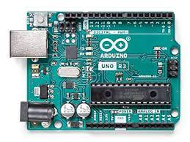
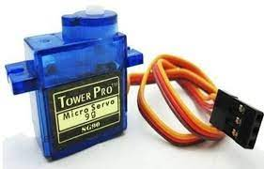
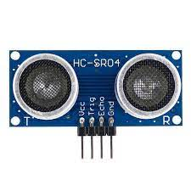
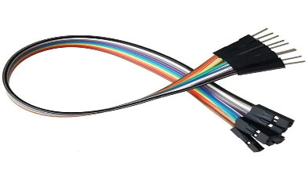
COMPONENTS REQUIRED
ARDUINO UNO
SERVER MOTOR
ULTRASONIC SENSOR
JUMPER WIRES

Slide 4
ULTARSONIC SENSOR
An ultrasonic sensor is an electronic device that measures the distance of a target object by emitting ultrasonic sound waves, and converts the reflected sound into an electrical signal.
Ultrasonic waves travel faster than the speed of audible sound (i.e. the sound that humans can hear).
Ultrasonic sensors have two main components: the transmitter (which emits the sound using piezoelectric crystals) and the receiver (which encounters the sound after it has travelled to and from the target).

Slide 5
ARDUINO UNO
Dimension:45.72mm x 66.04mm
Processor: ATMega328
Memory:
Flash Memory: 32KB
SRAM:2KB
EEPROM:1KB
Operating Temperature: -40-85ºC

Slide 6
SERVER MOTOR
A servo motor is a self-contained electrical device that moves parts of a machine with high efficiency and great precision.
In simpler terms, a servo motor is a BLDC motor with a sensor for positional feedback.
This allows the output shaft to be moved to a particular angle, position, and velocity that a regular motor cannot do.
However, a servo motor is only one part of a closed-loop motion control system.
A complete motion system includes an amplifier, control circuit, drive gears, potentiometer, shaft, and either an encoder or resolver as well as the servo motor.

Slide 7
BLOCK DIAGRAM
The ultrasonic sensor measures the distance between the coin and the sensor, which can be used to determine the coin type and value. The Arduino microcontroller processes this data, counts the number of coins inserted, and sends commands to the servo motor controller to move the servo motor and push the coin into the coin holder.
The servo motor controller receives commands from the Arduino and controls the position and speed of the servo motor to push the coin into the coin holder. The servo motor and the coin holder can be designed to work together to ensure that the coin is properly inserted and accepted into the coin holder.
Overall, this block diagram provides a high-level overview of the main components and functions of a coin eater device using an ultrasonic sensor, servo motor, and Arduino.
ARDUINO UNO
ULTRASONICSENSOR
SERVER MOTOR

Slide 8
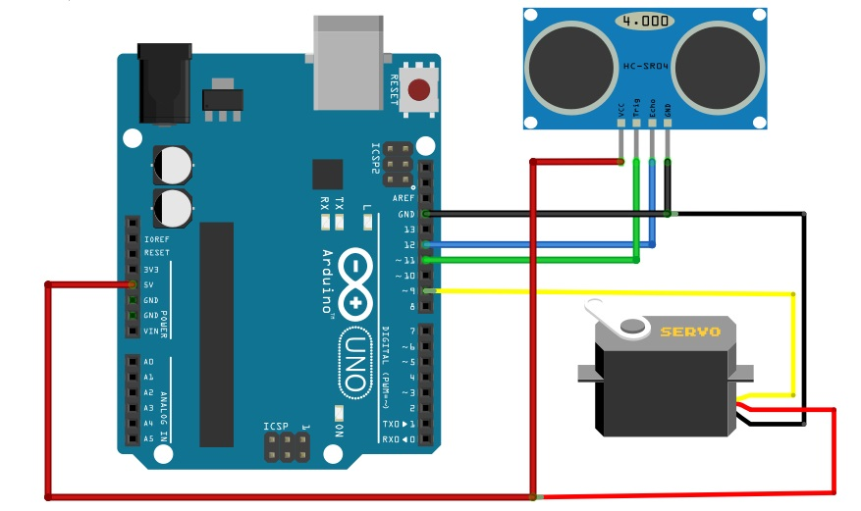
CIRCUIT DIAGRAM

Slide 9
WORKING OF CIRCUIT DIAGRAM
So let’s see the connection used in our project as we know that the ultrasonic sensor consists of four pins which are:
VCC
Ground
Echo
Trigger
So in order to connect the ultrasonic sensor with the Arduino we will perform the following steps:
Connect the ground of the ultrasonic sensor with the ground of the Arduino
Connect the VCC of the ultrasonic sensor with the 5V of the Arduino
Connect the Echo pin of the ultrasonic sensor with the digital pin 11 of the Arduino
Connect the trigger pin of the ultrasonic sensor with the digital pin 12 of the Arduino
Now in order to connect the servo motor to the Arduino:
Connect the VCC of the servo motor with the 5V of Arduino
Connect the ground of the servo motor with the ground of the Arduino
Connect the signal wire with the digital pin 9 of the Arduino

Slide 10
Limitations:
The Ultra Sonic Sensor can sence any type of object.
Instead we can use metal dedector.

Slide 11
Conclusion:
This project was intended to design a simple and low cost coin eater.
This is not only for coin bank but also used for dedecting any objects that you need and can store in a place or serach for a lost objects.
The whole system operates automatically.

